Slide 1
PerFectIT
C Design Review
March 21, 2018

Slide 2
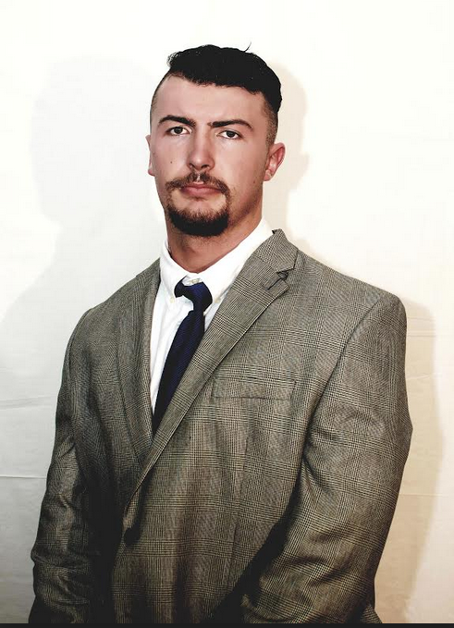
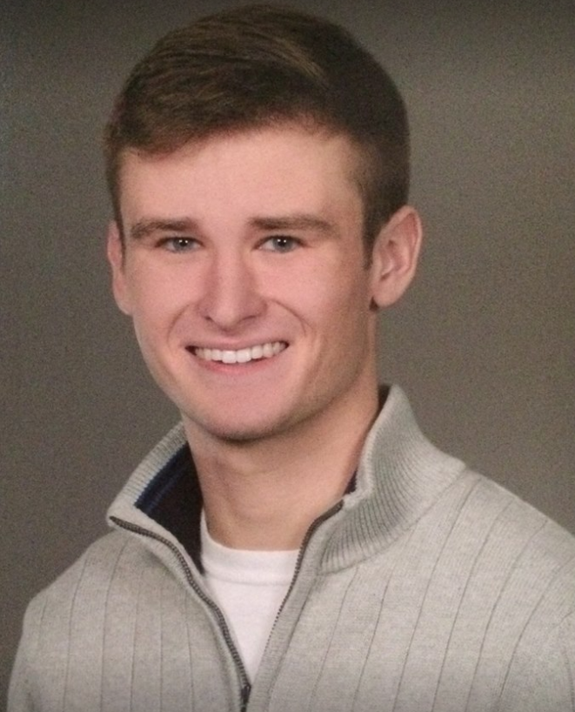
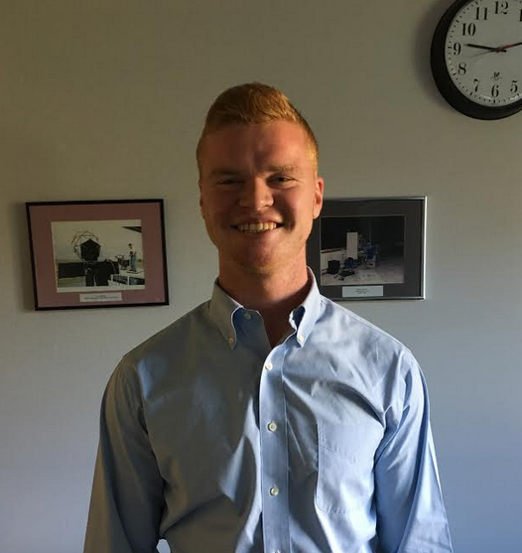
Introducing team members
Sai Yarram
Nick Raymond
Andrew Sjogren
Maxwell Gerhardson

Slide 3
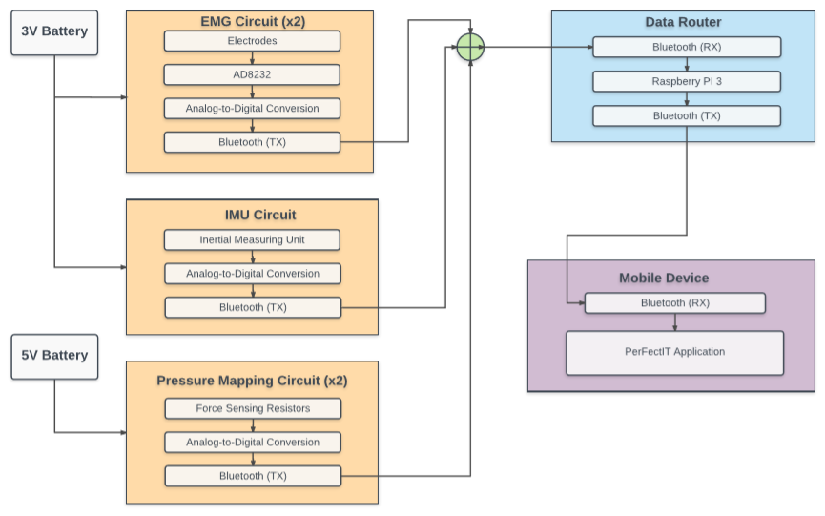
Block Diagram

Slide 4
Individual Responsibilities
Software Team
Sai Yarram
Server and Backend development and Implementation
User Authentication, Data Storage/Retrieval Implementation
UI and Algorithm Development
Nick Raymond
Hardware and Software Integration
Implementation of Bluetooth
Weight calibration analysis with FSR
UI and Algorithm Development
Hardware Team
Andrew Sjogren
Decision between FSR and Piezo Sensors
Implementation of chosen sensor into constructed foot insoles
Testing and calibration of foot insoles
PCB schematic design for foot insoles
Data collection
Maxwell Gerhardson
Design and implement AD8232 for EMG sensing into knee brace
PCB design for EMG sensing circuit
Implement 9DOF razor IMU
Data Collection

Slide 5
Inertial Measuring Unit
Inertial Measuring Unit
SparkFun 9DoF Razor IMU MO
Senses Euler angles:
< time, pitch, roll, yaw >
Communicates data to Raspberry Pi via Bluetooth
Warning system
Alert the user of poor form
Data analytics to be performed on Raspberry Pi

Slide 6
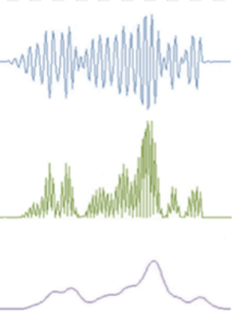
EMG Knee Brace
EMG Sensors
Conductive fabric electrodes
Signal detection
Sewn into knee brace
Analog Devices AD8232
Amplifier (~ 40dB of gain)
Filter (single-pole HPF @ 5Hz)
Feedback System
Give user info about how he/she drove through the squat

Slide 7
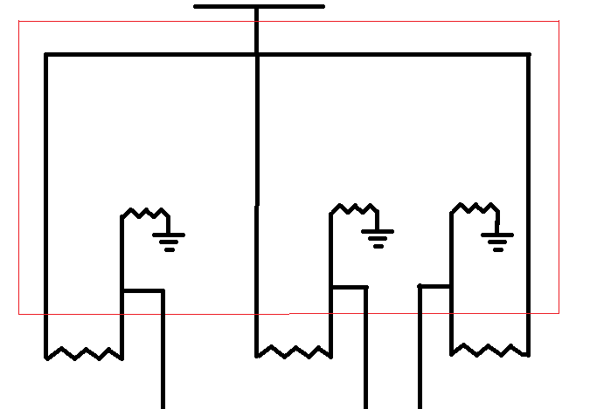
Foot Sensor Schematic (PCB Design)
5 V
710
710
710
FSR
FSR
FSR
V1
V2
V3

Slide 8
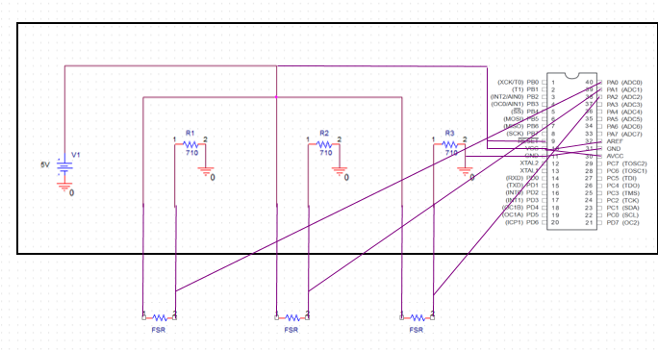
Foot Sensor Schematic (PCB Design)

Slide 9
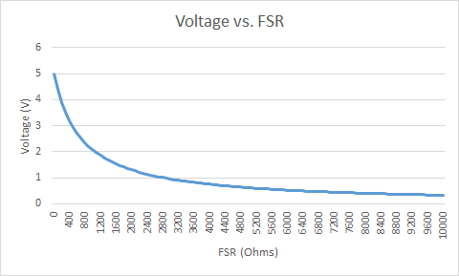
Foot Sensors

Slide 10
Power Budget

Slide 11
Software Design Specifications
Database Storage Options
SQLite
AWS
Firebase
SQLite
Light weight, no network access, relational
AWS
Cloud Service, User Authentication, Cloud Storage
Firebase
Cloud Service, User Authentication, NoSQL, Cloud Storage, Compatible

Slide 12
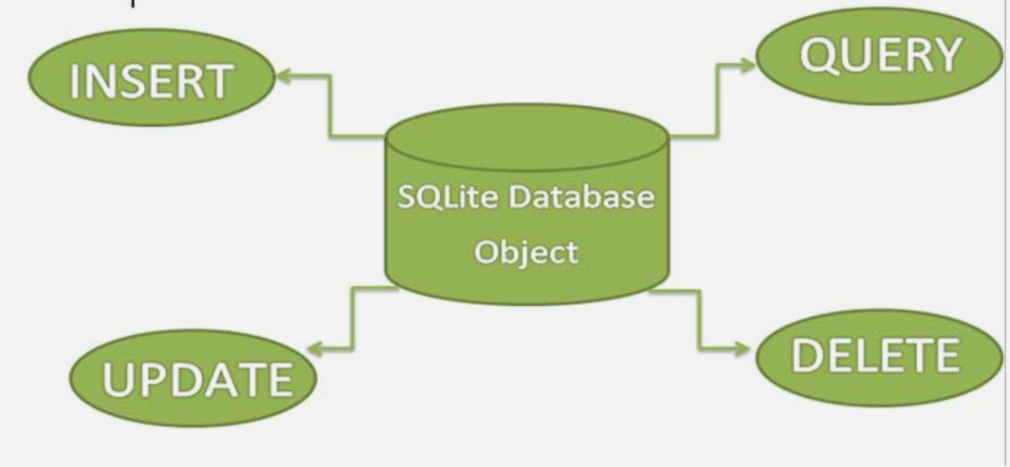
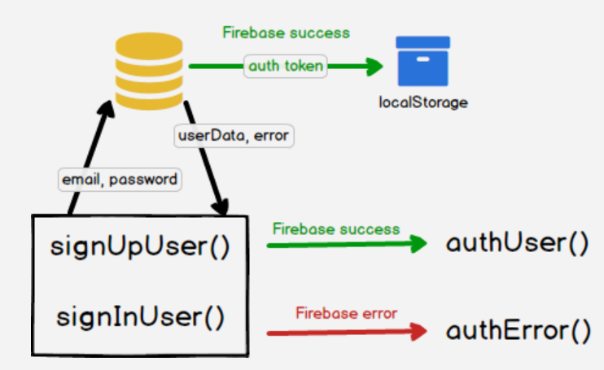
Data Store and Retrieve Protocol
MDR
Chose SQLite Implementation
Get the skeleton and the idea of the future fixed
Familiarize with graphics and intents
Looking into the future
Scale the project
Implement cloud service

Slide 13
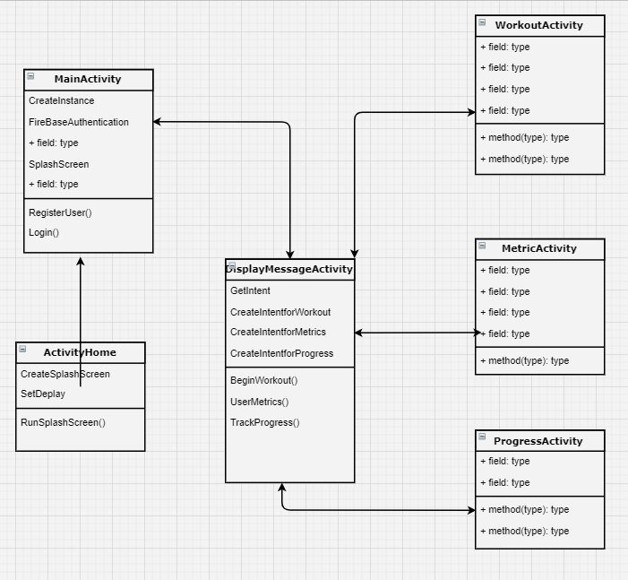
Block Diagram
Splash Screen
Main Activity
Display Message Activity
Branch:
Workout Activity
Metric Activity
Progress Activity

Slide 14
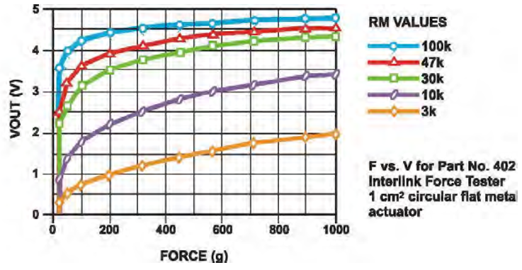
Weight Algorithm
Relative Weight
Leveling off at the top
Noise issues
Application Data Aggregates

Slide 15
Weight Calibration
-Good Relativity
-Inside of foot takes on more of weight with added load
-Clear weight shift from standing to squatting

Slide 16
Proposed CDR Deliverables
Sai Yarram
Have a fully functioning backend of the application
Integrate with the cloud and have a database setup
Authenticate Users, Stability, Analytics
Work with Nick Raymond on UI and Data Processing/Algorithms
Nick Raymond
Work on UI, Bluetooth Connection, and Data Processing
Connect the hardware to the app
Develop an algorithm with Sai Yaram
Andrew Sjogren
Complete PCB for foot mapping sensors
Communicate foot sensor data via bluetooth to Raspberry Pi
Work with Max to communicate data to Android
Testing / debugging of integrated subsystem
Max Gerhardson
IMU
Complete PCB for emg sensors
Communicate EMG data via bluetooth to Raspberry Pi
Work with Andrew to communicate data to Android
Testing / debugging of integrated subsystem

Slide 17
Schedule
 | 1/10 | 1/30 | 2/10 | 3/21 | 4/28
Design PCB for EMG and FSR circuits
Configure IMU
Communicate sensor data to Raspberry Pi
Communicate data from Pi to mobile app
Test and debug system
Fully Functioning Back End
Finalize Algorithm
Integrate Cloud + Database Setup
Bluetooth Connection
= Max & Andrew
= Nick & Sai

Slide 18
Thank you
Questions?

